Slide 1
A PROPOSAL TO HER EXCELLENCY
Senator Oluremi Tinubu, CON, OON
First Lady of the Federal Republic of Nigeria
Chairperson, Renewed Hope Initiative
No Nigerian
Beyond Reach
Border Communities and National Development — assessing the vulnerabilities, challenges and development needs of Nigeria’s most disadvantaged and sensitive communities
THE RENEWED HOPE FRONTIER PROGRAMME · AUGUST 2026
Notes:
Open by thanking Her Excellency. This deck is about 20 million Nigerians living within 25km of our international borders. The ask at the end is small: N30 million for a six-month assessment.

Slide 2
Nigeria does not end
at her borders.
Nigeria begins there.
Notes:
Pause here. This is the framing sentence for the entire proposal.

Slide 3
THE PEOPLE THIS IS ABOUT
20
For comparison
▸
More than the population of
LAGOS STATE
▸
More than the population of
MILLION NIGERIANS
RWANDA
live within 25 kilometres of an international border — approximately 14% of the entire population of this country.
▸
More than the population of
BENIN REPUBLIC
And they have never been counted, community by community, even once.
Notes:
Emphasise the Lagos comparison — it lands with every Nigerian audience.

Slide 4
WHAT THIS LOOKS LIKE ON THE GROUND
Three ordinary Nigerian lives
A mother
A child
A family
In Banki, she walks across the border into Cameroon to deliver her baby, because there is no functioning delivery room on the Nigerian side. Her child is Nigerian. No document in the world says so.
In Idiroko, she crosses into Benin Republic every morning to attend school. She comes home speaking a language her own mother does not speak, and singing another country’s anthem before she sings ours.
In Sabon Birni, they cross into Niger Republic to fetch drinking water. They have not turned away from Nigeria. Nigeria has simply not yet arrived.
Illustrative of conditions documented across Nigeria’s border communities.
Notes:
Slow down here. These three cards carry the emotional weight of the entire presentation.

Slide 5
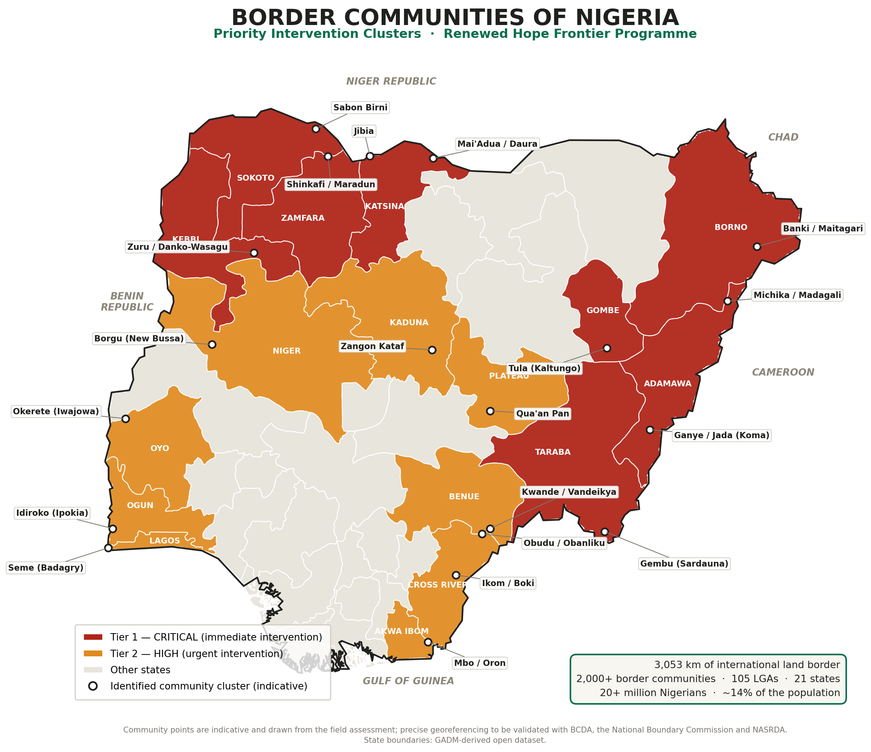
WHERE THEY ARE
The frontier of Nigeria
3,053 km
TIER 1
of international land border with Benin, Niger, Chad and Cameroon
Immediate
intervention
2,000+
recognised border communities
TIER 2
Urgent
intervention
105
Local Government Areas
21
States of the Federation
Community points indicative pending georeferencing in Phase 0, with BCDA, the National Boundary Commission and NASRDA.
Notes:
Point out that no equivalent map with verified coordinates and vulnerability scores currently exists.

Slide 6
THE CONSEQUENCE
A family gives its loyalty
to whoever gives it water.
In February 2026 the Senate Committee on States and Local Government Affairs warned that because facilities are not provided for border communities, those communities sometimes give their allegiance to neighbouring countries — crossing over for schooling, and in some cases simply to fetch water.
This is not disloyalty. It is arithmetic.
Notes:
The phrase used publicly was a crisis of allegiance. Reframe it gently: these families have not left Nigeria.

Slide 7
WHY THIS IS NOT ONLY A HUMANITARIAN QUESTION
What the neglect costs Nigeria
Security
Sovereignty
Public health
Undergoverned space becomes staging ground. Every kilometre without a school, a clinic and a road is a kilometre available to somebody else.
Communities dependent on a neighbour for water, medicine and schooling gradually reorient their civic life across the line.
Outbreaks arrive in Nigeria before Nigeria knows they exist. Maternal deaths occur on the road, unrecorded.
Legal invisibility
Lost economy
A citizen with no birth certificate and no NIN is a citizen the State cannot see — and therefore cannot serve.
3,053 km of frontier is 3,053 km of potential trade corridor. Formalised, it is a revenue base. Neglected, it is a smuggling economy.
Notes:
Five costs. Security is the one that unlocks Federal attention; legal invisibility is the one that unlocks the First Lady's own agenda.

Slide 8
THE PROBLEM IS NOT THE MONEY
₦50 billion is already appropriated.
What has never existed is a map of where the need actually is.
₦50bn
0
₦30m
appropriated for border community development in the current budget cycle
authoritative, georeferenced vulnerability scores for Nigeria’s 2,000+ border communities
the cost of producing them, and a costed national plan, in six months
Without a register, allocation drifts toward wherever a request is loudest — not toward where the need is greatest.
Notes:
This is the pivot of the pitch: the constraint is evidence, not funding. That is what makes a N30m ask reasonable.

Slide 9
THE PROPOSAL
The Renewed Hope
Frontier Programme
A flagship initiative of the Renewed Hope Initiative

Slide 10
TWO HALVES — AND THE FIRST MAKES THE SECOND POSSIBLE
Assess, then transform
01
02
ASSESS
TRANSFORM
Build the Frontier Vulnerability Index and the National Frontier Register — the first authoritative, georeferenced, community-by-community measurement of vulnerability across all 2,000+ border communities.
Nigeria has never had one. Without it, every naira spent at the frontier is spent blind.
Deliver a costed, sequenced package through five programme pillars — water, health, education, energy, livelihoods, identity, and the health coverage that keeps it all running.
Beginning with a 100-Day Frontier Compassion Sprint in one community in every border State.
Notes:
Stress the sequencing. Nobody is being asked to fund construction today.

Slide 11
ALIGNMENT
Inside the Renewed Hope Agenda, not alongside it
The Programme contributes directly to seven of the President’s eight priority areas — in the geography where each is hardest to achieve.
Food security
Ending poverty
Growth & job creation
Access to capital
Improving security
Inclusivity: women & youth
Fighting corruption
And all five pillars of the Renewed Hope Initiative
Agriculture
Economic Empowerment
Social Investment
Health
Education
Notes:
Seven of eight presidential priorities, five of five RHI pillars. This programme is not a new direction; it is the existing direction extended.

Slide 12
THE MOST IMPORTANT SLIDE IN THIS DECK
Your Excellency has already begun this work
This Programme does not ask you to start something new. It asks you to carry two things you have already begun to the one part of Nigeria they have not yet reached.
Birth registration
The fight against cervical cancer
Launched with UNICEF, the National Population Commission, the Federal Ministry of Health and Social Welfare and NIMC.
₦1 billion committed to the National Cancer Fund, with screening and HPV vaccination driven across all six geopolitical zones.
At the frontier, the absence of a certificate does not only deny a child services — it erodes the claim to the nationality itself. This is the highest-yield place in Nigeria to extend the campaign.
Frontier women are the least screened women in the Federation — and the most reachable, because a basic handset is the one piece of infrastructure the frontier already has.
Notes:
This is the persuasive centre of gravity. Frame the whole proposal as the completion of work she already owns.

Slide 13
PILLAR ONE — THE FLAGSHIP
The Frontier Mother
& Child Corridor
A continuous corridor of maternal and child care along Nigeria’s entire land frontier.
A staffed, equipped delivery point within reach of every intervention community
A birth registration point co-located with every delivery point, wired into the national drive
Every pregnant woman identified and followed by a trained Frontier Hope Ambassador
Cervical cancer screening and HPV vaccination extended to frontier women and girls
A paid, on-call emergency transport arrangement in every cluster
Every child born in a Renewed Hope Frontier community leaves with two things: a healthy mother, and a Nigerian birth certificate.
Notes:
The signature commitment. Say it slowly — it is the line that will be quoted back.

Slide 14
PILLARS TWO, THREE, FOUR AND FIVE
What changes in a frontier community
2
3
4
5
Water, Light
& Learning
Livelihoods
& Border Markets
Identity
& Belonging
Health
Coverage
A solar borehole. A solar mini-grid for the clinic, school, market and water point. Classrooms rehabilitated, teachers deployed with a frontier allowance, school feeding, and accelerated learning for children returning from schooling across the border.
Agricultural inputs and dry-season irrigation. Women-led savings and loan associations. Skills tied to real local demand. International border markets that convert informal cross-border trade into recorded, protected commerce. A dedicated youth track.
Mass birth registration and NIN enrolment. Civic education in the local language. Restoration of the Nigerian curriculum. Community development committees with real standing and mandatory female and youth representation.
Every household enrolled in the NHIA’s Vulnerable Group Fund through the existing national architecture — but only once the facility is equipped, staffed and accredited. Recurrent care financed by statute, not by a project budget that ends.
Notes:
Keep this brisk — the detail is in the written proposal.

Slide 15
WHAT ALWAYS HAPPENS HERE
The outbreak is not a risk
to this Programme.
It is the proof the Programme is overdue.
4,000+
4%
22,000
70+
suspected cholera cases in Borno this year, with 39 deaths
case fatality rate in the outbreak Bauchi declared on 31 July
suspected diphtheria infections in one year, northern Nigeria
deaths in the meningitis outbreak across 23 states
Children under five are the age group most affected by cholera. The NCDC names the cause plainly: no potable water, no sanitation.
Notes:
These are Nigerian numbers from this year and last. Do not editorialise — read them and move on.

Slide 16
WHEN AN OUTBREAK REACHES A BORDER COMMUNITY TODAY
Six things that cannot be done
✕
Treat cholera
✕
Vaccinate anyone
✕
Count the children
The treatment is rehydration in clean water. Without a water point, the cure requires the thing whose absence caused the disease.
Vaccines need 2–8°C. No power, no refrigerator, no cold chain — only a cold box with hours of life in it.
A campaign needs a denominator. No birth registration means coverage cannot be measured and defaulters cannot be traced.
✕
Isolate a patient
✕
Trace the contacts
✕
Warn the community
With no health centre, patients are nursed at home by unprotected relatives, and household transmission does the rest.
Response teams travel by road. Where the road floods for months, tracing is done on foot — or not at all.
No network, no radio, no local-language channel. Rumour fills the vacuum, and refusal follows.
And before all six: you cannot respond to an outbreak you never detected. Surveillance begins when a clinician notifies the LGA — so where there is no clinic, there is no data at all.
Notes:
This is the slide the technical people in the room will remember. Take it slowly.

Slide 17
NO EXTRA LINE ITEM. NO EXTRA NAIRA.
Every naira spent twice
Everything already in this Programme does one job on an ordinary day and a completely different job on the worst day.
WHAT WE BUILD
ON AN ORDINARY DAY
IN AN OUTBREAK
Solar borehole
Ends the walk across the border for water
Interrupts cholera at source; supplies the clean water rehydration needs
Solar mini-grid
Lights the school and the delivery room
Runs the vaccine fridge — the cold chain that makes any campaign possible
Health centre
Antenatal care and childhood illness
Case management and isolation; a treatment centre a response team can use
Birth registration
Gives a child legal existence
The denominator without which vaccination coverage cannot be measured
Access road
Market, school, referral
Carries the response team and the vaccines — in the rainy season, when outbreaks peak
Hope Ambassadors
Antenatal follow-up and WASH caretaking
Contact tracing and risk communication in the language the household speaks
The Frontier Line
Report a broken borehole
Risk communication — one message to every enrolled household, in their language
OutbreakVoice
Carries routine traffic that builds the baseline
Detection: illness reported by voice, clustered into a signal, escalated to the NCDC
Notes:
Say it once: this is the same budget. Nothing here is an addition.

Slide 18
You cannot treat cholera
without water.
This is not a water project that happens to help in an epidemic. It is the epidemic preparedness of twenty million Nigerians — delivered as boreholes, clinics, light, roads and a phone number, and useful every single day in between.
Nigeria will spend this money either way. The only question is whether it is spent before the outbreak, or after it.
Notes:
Close this block here. The next slide returns to the delivery model.

Slide 19
WHY THIS WILL WORK WHERE OTHER EFFORTS HAVE NOT
Four design decisions
1
Targeting by evidence, not advocacy
2
Delivered by frontier women
Every community scored on the Frontier Vulnerability Index and fixed to GPS coordinates before a naira is committed.
A trained, paid cadre of Frontier Hope Ambassadors resident in every community — the delivery mechanism, the accountability mechanism and the empowerment intervention, all at once.
3
Technology already built, and Nigerian
4
Public proof of delivery
Health screening, maternal support and outbreak reporting over WhatsApp, SMS and basic handsets in local languages. This Programme does not have to invent them.
Geotagged, photographed, timestamped completion on an open dashboard any Nigerian, any journalist and any legislator can inspect.
Notes:
Decision two is the one to dwell on: frontier women as the delivery cadre.

Slide 20
THE INSTRUMENT
The Frontier Vulnerability Index
Nigeria cannot fix what Nigeria has never measured. Eight weighted domains. One score, 0–100, for every border community — attached to a verified coordinate.
18%
15%
15%
12%
Health Access
Water & Sanitation
Education
Infrastructure & Energy
12%
12%
10%
6%
Livelihoods
Security & Governance
Civic Identity
Cross-Border Dependency
The output is the National Frontier Register — published as a live public dashboard, and transferred into public ownership at no cost to Government.
Notes:
Emphasise that the Register becomes national infrastructure, usable by BCDA, the NBC, the National Assembly and every partner.

Slide 21
THE ONE NUMBER
Cross-Border Dependency Rate
The proportion of households that crossed an international border in the last twelve months to obtain water, health care or schooling. No other programme reports it.
−50%
−80%
within 24 months in every intervention community
within 60 months
“No Nigerian should have to leave Nigeria to receive what Nigeria owes them.”
Notes:
Targets are against a baseline established in Phase 0.

Slide 22
THE DELIVERY MODEL
Frontier Hope Ambassadors
Every intervention community recruits and trains a cadre of resident women — selected with the traditional and religious leadership, paid a stipend, and equipped with a basic phone.
They find every pregnant woman
They find every child out of school
and follow her through delivery and registration
and every household in acute need
They keep the borehole working
They lead the savings groups
as trained WASH caretakers with a spare-parts chain
and report the first sign of an outbreak or an incursion
50,000 frontier women trained, respected and earning by year five — the delivery mechanism and the legacy, in one.
Notes:
If only one design decision survives scrutiny, it should be this one.

Slide 23
PHASE 1
The 100-Day Frontier Compassion Sprint
Twenty-one communities. One in every border State. A complete package in one hundred days — so the Programme is visible, proven and photographed inside its first year.
21
500,000
21
21
communities, one per border State
people reached
solar-powered boreholes
primary health centres equipped
50,000
525
21
21
births registered
frontier women trained and earning
solar mini-grids serving clinic, school and market
State launches hosted by Governors’ Spouses
Phase 1 subject to unit costs validated during Phase 0.
Notes:
Twenty-one State launches is also twenty-one opportunities for national coverage.

Slide 24
SEQUENCING
From evidence to national coverage
Frontier Assessment: the FVI, 21 sentinel community assessments, the National Frontier Register, the public dashboard and the costed national plan
₦30 million
Phase 0
Months 0–6
The 100-Day Frontier Compassion Sprint — 21 communities, one in every border State
₦2.4 billion
Phase 1
Months 4–9
Renewed Hope Frontier 250 — the 250 highest-need communities, plus the first six international border markets
₦21 billion
Phase 2
Months 9–33
National coverage of all 2,000+ border communities, blended with Federal, State and partner funding
₦180 billion
Phase 3
Years 3–8
Only Phase 0 is requested for immediate approval. Phase 1–3 figures are indicative planning estimates, to be replaced by field-validated unit costs in Phase 0.
Notes:
Be explicit: no commitment beyond N30m is being sought today.

Slide 25
THE REQUEST
What we respectfully ask of Your Excellency
1
Adopt the Renewed Hope Frontier Programme as a flagship initiative of the Renewed Hope Initiative
₦30m
2
Approve ₦30,000,000 for Phase 0 — the six-month Frontier Assessment
What it buys
Constitute the Frontier Programme Council under your chairmanship
A defensible national evidence base for 20 million citizens
The first authoritative register of Nigeria’s frontier
A public dashboard the whole country can inspect
A costed plan that turns ₦50bn already appropriated into verified delivery
Recorded testimony from frontier mothers, teachers and elders
3
4
Invite the Governors’ Spouses Forum to name a State Frontier Patron in each of the 21 border States
5
Receive the findings at a National Frontier Summit in month six, launching the 100-Day Sprint
Notes:
Land the contrast: a modest, self-contained ask against a very large national return.

Slide 26
THE LEGACY
Every First Lady of Nigeria
is remembered for one thing.
Mother of the Frontier.
The First Lady who went to the very edge of the country, and brought twenty million Nigerians back into the picture.
Nigeria does not end at her borders. Nigeria begins there.
Notes:
Close here and stop. Do not add anything after this slide.

Slide 27
Thank you
Submitted by
Dr. Joseph Olowe, DPT, MSc, MBA
Founder & Chief Executive Officer
Josmol Group Inc. · DoktorConnect · in partnership with Omega Wellness Center
THE RENEWED HOPE FRONTIER PROGRAMME · NO NIGERIAN BEYOND REACH

